Slide 1
EF AFRICA
Datacentres and Markets
February 2024

Slide 2
Data Centre Immersion Cooling
The latest CPUs, GPUs, and servers are getting smaller in footprint and faster in processing, and therefore substantially hotter than ever before. Traditional methods of air-cooling can no longer keep pace with the thermal management requirements of these new devices. In addition, the space, complexity, maintenance, capital, and operating costs of a traditional CRAC retrofit destroy margins while not even buying enough headroom to ever recover the investment.
What is needed is an entirely new approach to datacenter cooling. An approach that:
Enables PUEs of 1.03-1.05 without exotic locations, engineering, or hyper-scale
Reduces capital investment by up to 40%
Reduces IT room footprints up to 80%
Reduced operating costs by up to 50%
Enables off the shelf servers to achieve NEBs compliance with no additional engineering.

Slide 3



























Over 11,000 Customers in Production Today in Servers, Datacenter's, Batteries, and more

Slide 4
Engineered Fluids supplies
World-leading Dielectric Coolant manufactured in Tyler Texas
500 000 litre weekly capacity
60kV dielectric strength
Non-Toxic
Bio-degradable
Food grade
25-year shelf life
World Leading Single Phase immersion ready tanks and systems
Both EIA and OCP
PUE of 1,03 -1,05
Low pressure
Modular systems
300kw heat dissipation per tank

Slide 5
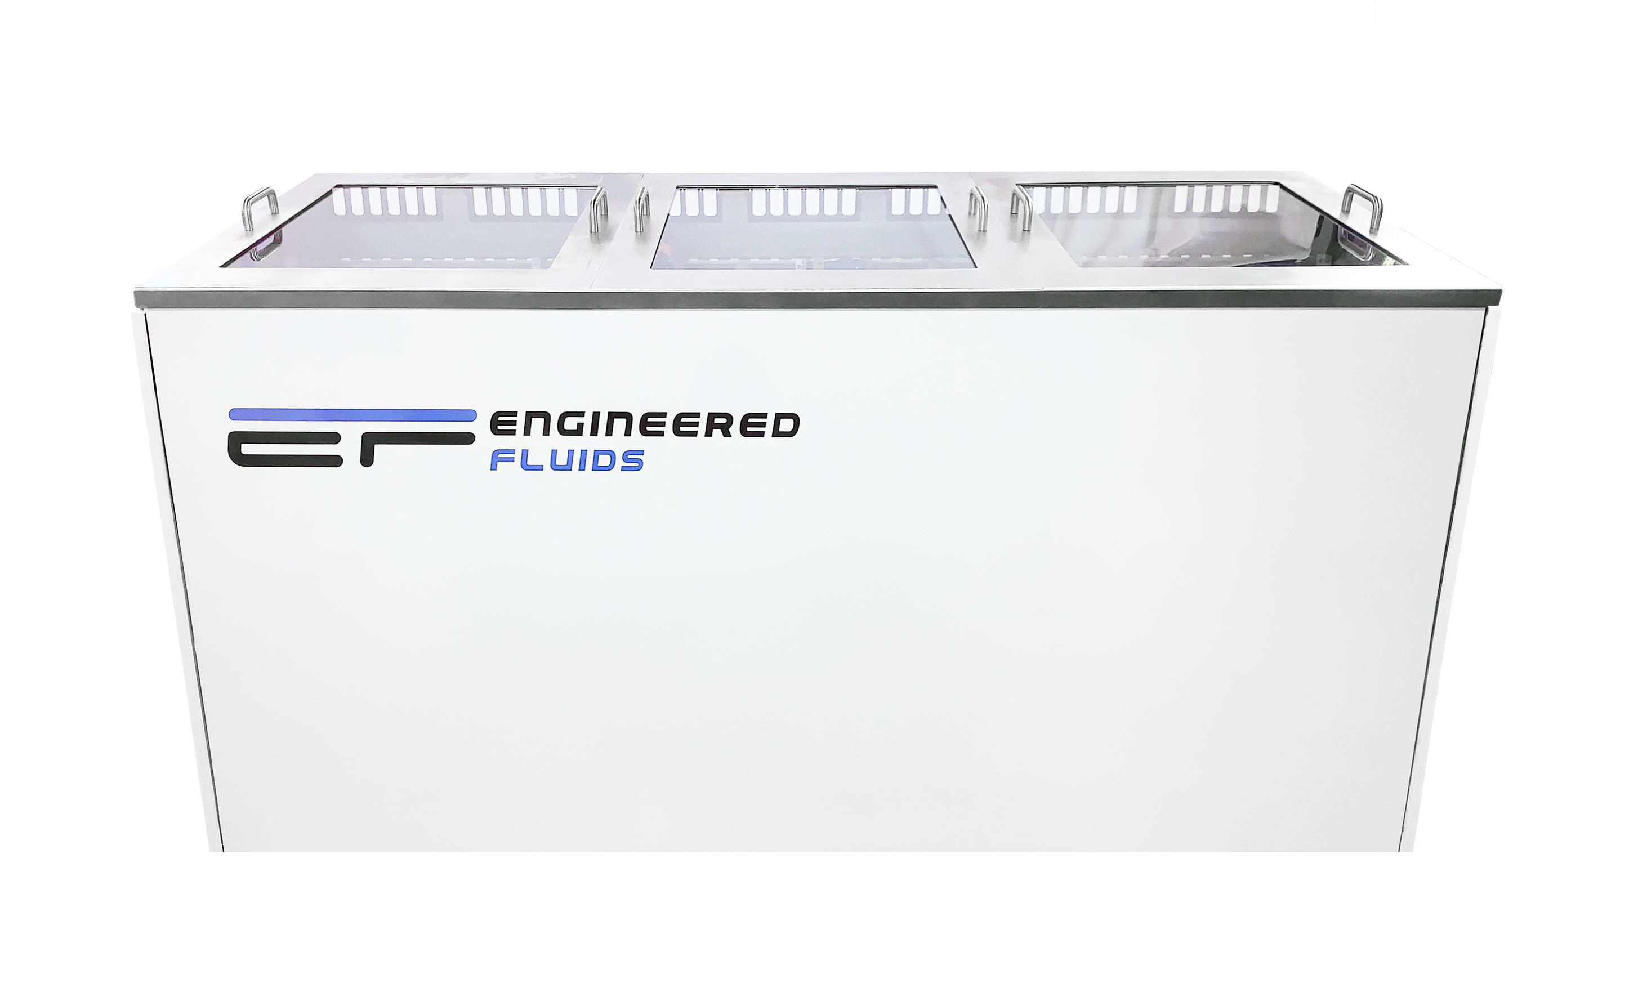
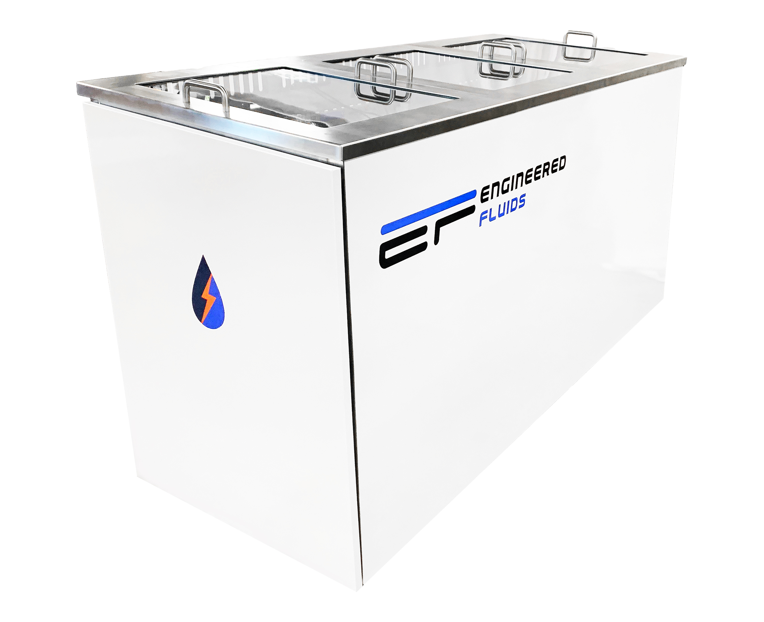
Engineered Fluids SLIC tanks

Slide 6
SLIC Tanks set in modular design
Both EIA and OCP
Accommodates redundancies N+X
Easy to comply utilising existing water supplies and distribution guidelines
Eliminate all cooling costs
Future proof for extreme rack densities
Heat management eliminated reducing the footprint required by 80%
Local presence in SA

Slide 7
Thank You
Dani Yudelowitz
0829611666 dani.yudelowitz@engineeredfluids.com

